Slide 1


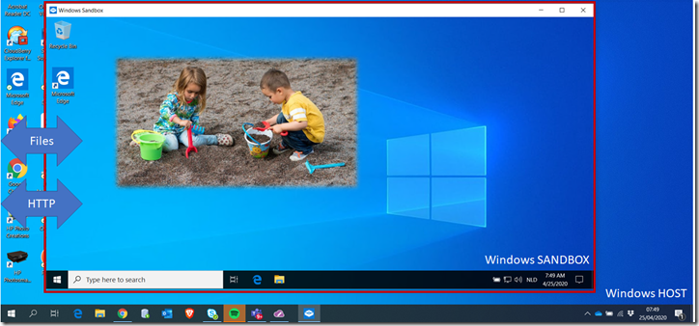

Code Café Online DBeaver DirectPoll Devoxx Windows Sandbox
Code Café Online- 4 May 2020
Henk Jan van Wijk & Lucas Jellema
Resources: https://bit.ly/codecafe0405

Slide 2
DBeaver

Slide 3

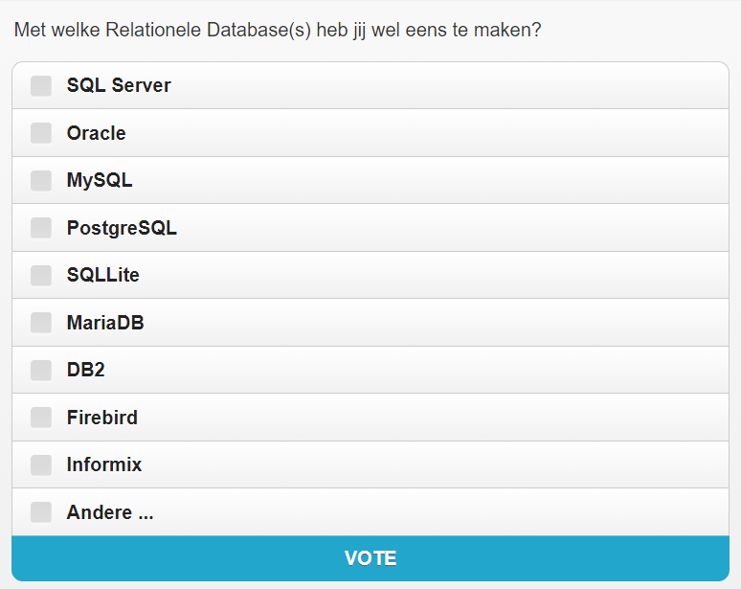
DirectPoll
http://etc.ch/Ztuv

Slide 4
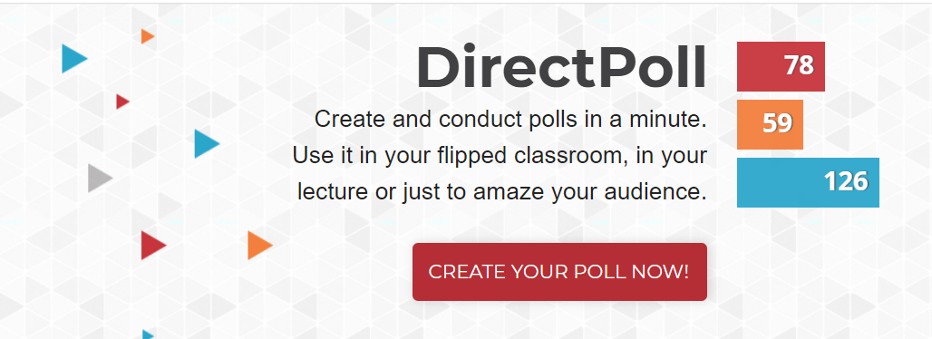
DirectPoll
https://directpoll.com/

Slide 5
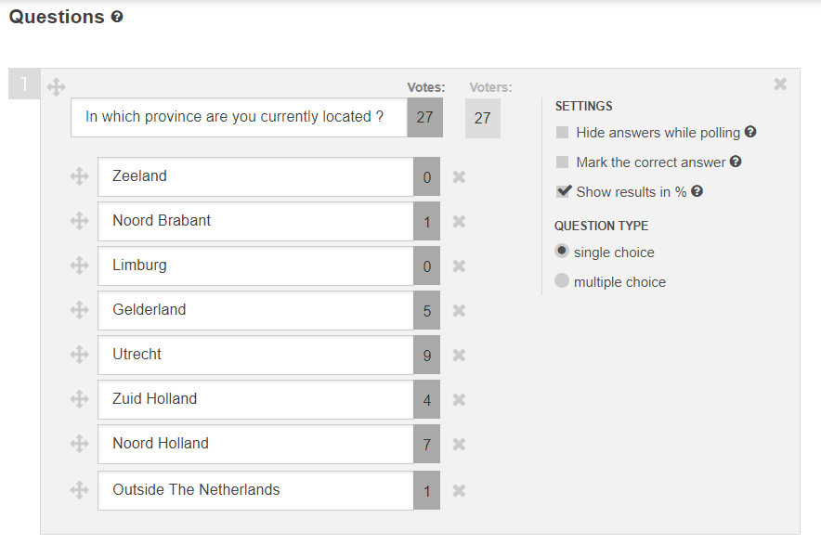
DirectPoll
Multiple Choice questions
single or multiple response
answers can marked as correct
Live result gathering
Presented as horizontal bar charts
Results are retained for analysis at a later moment
Polls can be reused
Maximum 500 concurrent voters
Free

Slide 6

Devoxx
Notes:
https://www.youtube.com/watch?v=J6fegDQPgps&list=PLRsbF2sD7JVqPgMvdC-bARnJ9bALLIM3Q

Slide 7
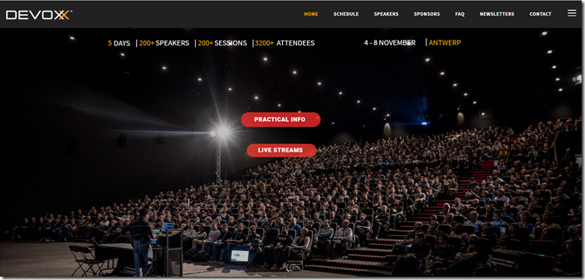

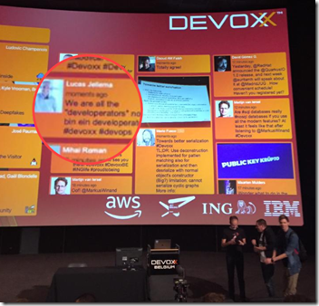

Devoxx Belgium 2019
Notes:
https://technology.amis.nl/2019/11/11/the-state-of-java-developers-reflections-on-devoxx-2019/

Slide 8
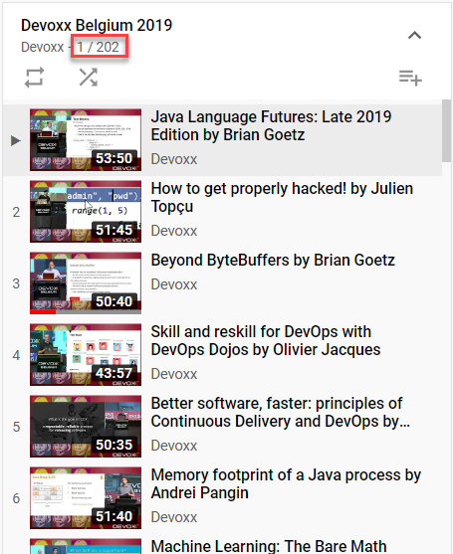
Devoxx Belgium 2019
Full Playlist on YouTube
https://www.youtube.com/watch?v=J6fegDQPgps&list=PLRsbF2sD7JVqPgMvdC-bARnJ9bALLIM3Q
Notes:
https://www.youtube.com/watch?v=J6fegDQPgps&list=PLRsbF2sD7JVqPgMvdC-bARnJ9bALLIM3Q

Slide 9
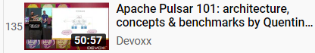
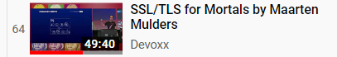
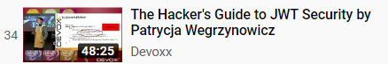
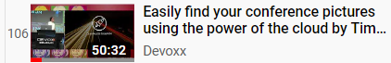
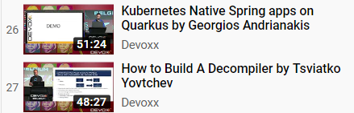
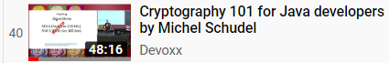
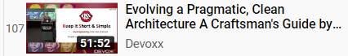
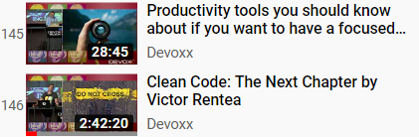
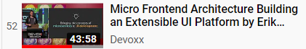
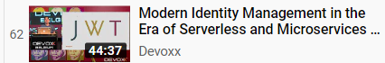
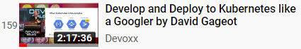
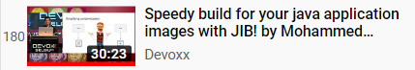
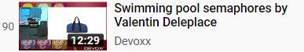
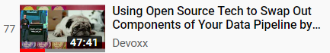
Devoxx Belgium 2019 What to Watch?

Slide 10
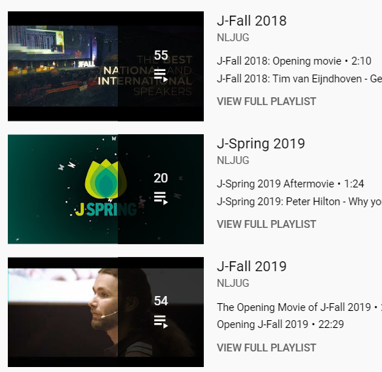
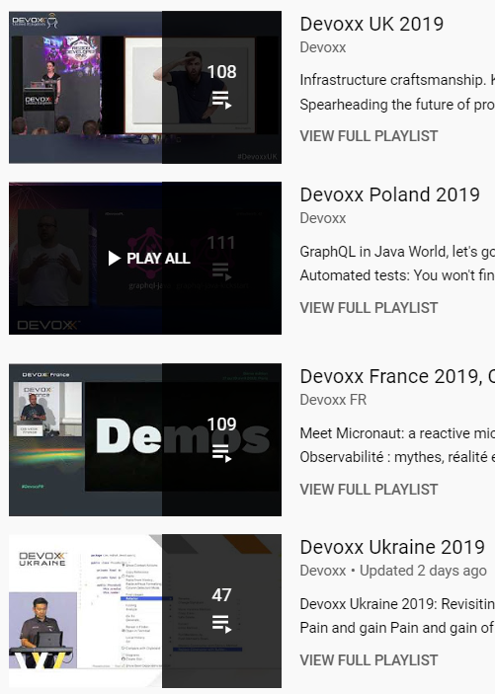
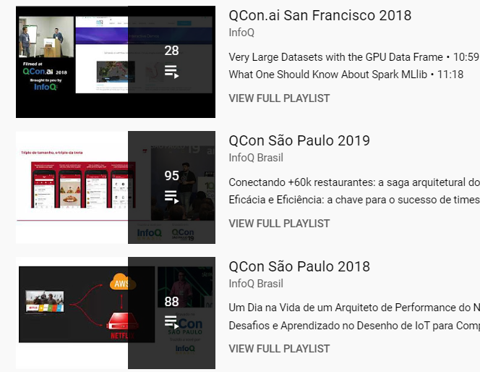

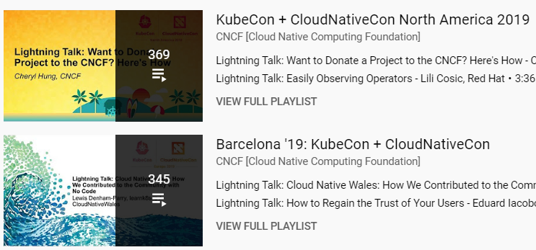
Wait…. There is more…

Slide 11
Windows Sandbox
Part of Windows 10 – 1903 and later (installed on my laptop in mid April 2020)

Slide 12
Windows Sandbox is a new lightweight desktop environment tailored for safely running applications in isolation.
Part of Windows – everything required for this feature ships with Windows 10 Pro and Enterprise. No need to download a VHD!
Pristine – every time Windows Sandbox runs, it’s as clean as a brand-new installation of Windows
Disposable – nothing persists on the device; everything is discarded after you close the application
Secure – uses hardware-based virtualization for kernel isolation, which relies on the Microsoft’s hypervisor to run a separate kernel which isolates Windows Sandbox from the host
Efficient – uses integrated kernel scheduler, smart memory management, and virtual GPU

Slide 13
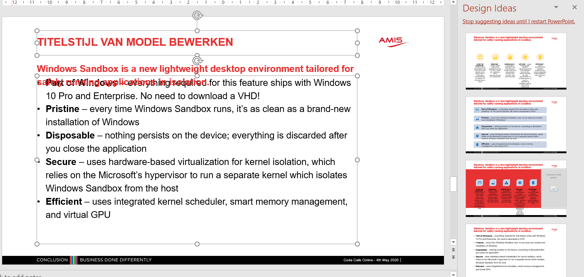
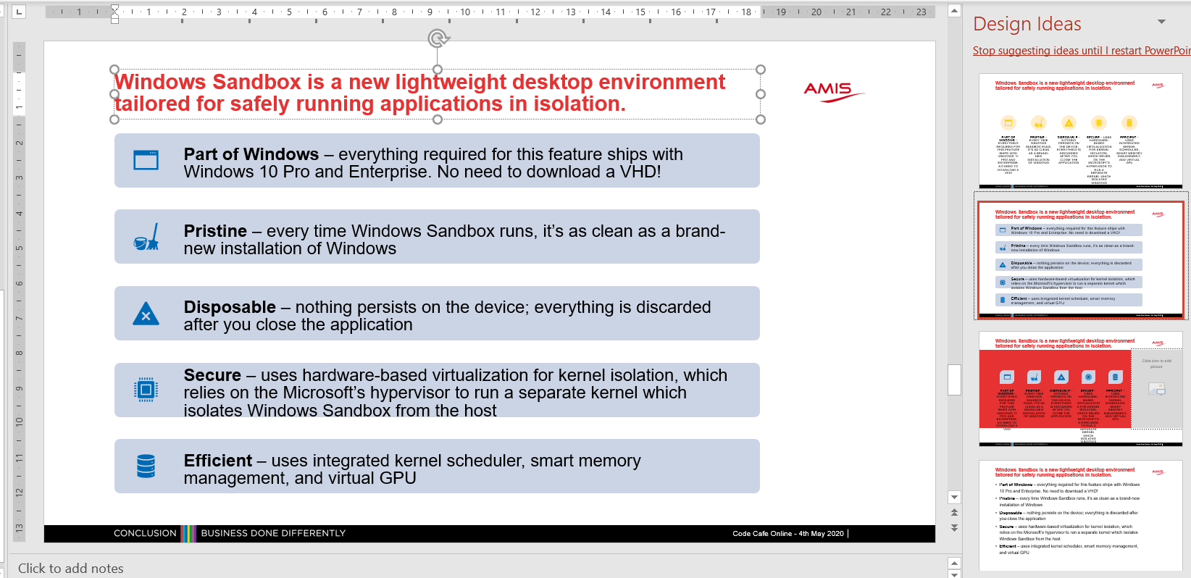
Intermezzo: Powerpoint Design Ideas

Slide 14
Windows Sandbox is a new lightweight desktop environment tailored for safely running applications in isolation.
Part of Windows – everything required for this feature ships with Windows 10 Pro and Enterprise. No need to download a VHD!
Pristine – every time Windows Sandbox runs, it’s as clean as a brand-new installation of Windows
Disposable – nothing persists on the device; everything is discarded after you close the application
Secure – uses hardware-based virtualization for kernel isolation, which relies on the Microsoft’s hypervisor to run a separate kernel which isolates Windows Sandbox from the host
Efficient – uses integrated kernel scheduler, smart memory management, and virtual GPU

Slide 15
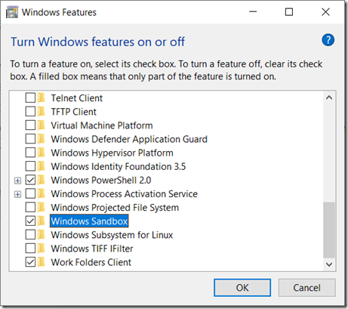
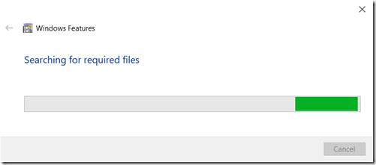
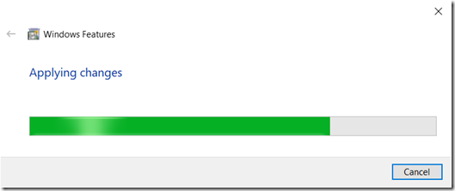
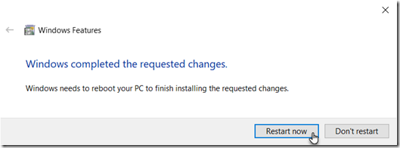
How to get going
You need Windows 1903 (build 18305) or later
Turn Windows Sandbox feature on

Slide 16
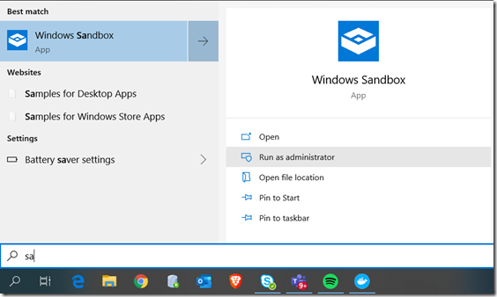
How to get going (2)
After the reboot:
Warning: Windows Sandbox and VirtualBox do not play together
After running the Sandbox, you need to “undo” Windows virtualization in order to run VirtualBox again

Slide 17
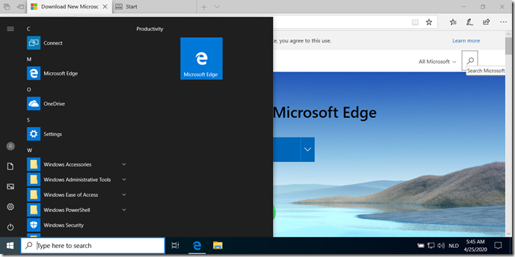
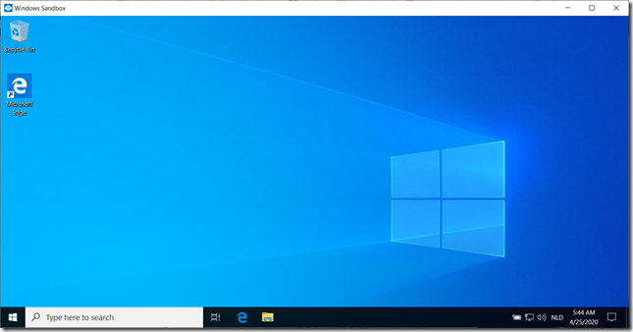
Inside the Sandbox

Slide 18
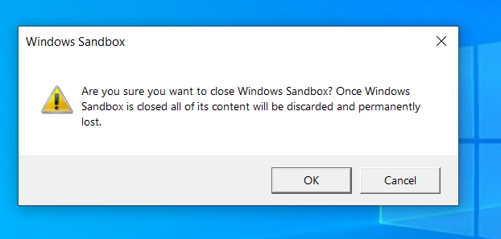
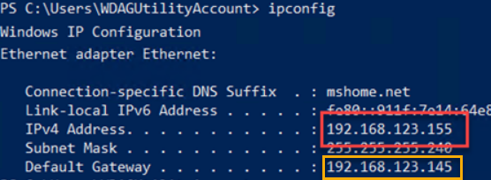
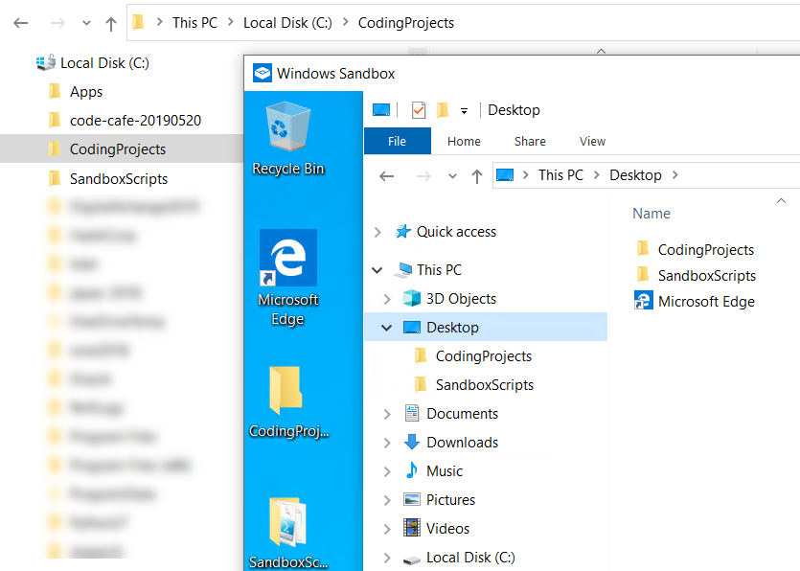
What else is there to know?
When you stop the Sandbox, its contents is destroyed
The Sandbox has its own IP address
Can interact over network with Host (and vice versa)
Can interact with the rest of the world
Folders on host can be shared with Sandbox
Mapped to a fixed path inside the Sandbox C:\users\wdagutilityaccount\desktop\
Notes:
https://techcommunity.microsoft.com/t5/windows-kernel-internals/windows-sandbox/ba-p/301849
https://docs.microsoft.com/en-us/windows/security/threat-protection/windows-sandbox/windows-sandbox-configure-using-wsb-file

Slide 19
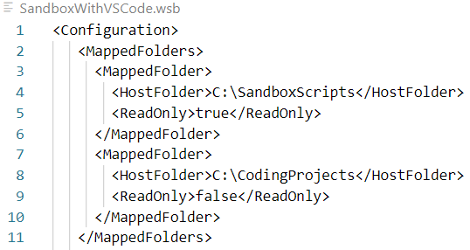
Folder Mapping from Host to Sandbox
HOST

Slide 20
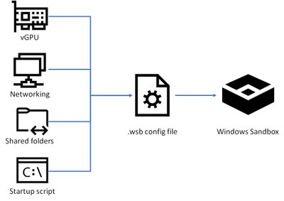
What else is there to know?
Sandbox can be started from a specific wsb configuration file, that defines
Shared Folders
A single (Powershell, CMD) Startup Script
vGPU, Memory
(what) Networking (is allowed)
Audio/Video/ClipBoard/ProtectedClient
Notes:
https://techcommunity.microsoft.com/t5/windows-kernel-internals/windows-sandbox/ba-p/301849
https://docs.microsoft.com/en-us/windows/security/threat-protection/windows-sandbox/windows-sandbox-configure-using-wsb-file

Slide 21
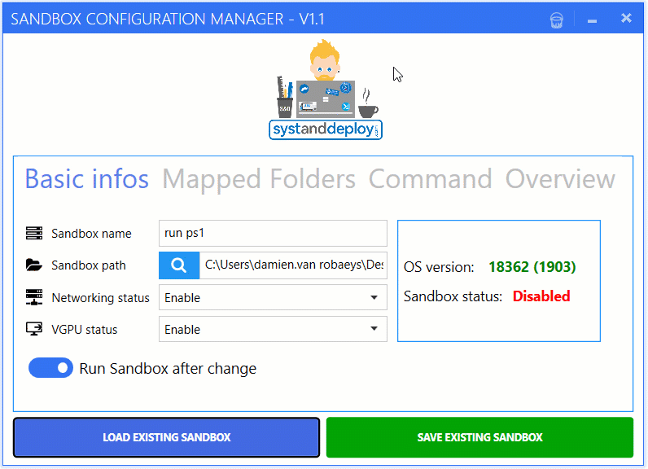
Windows Sandbox Editor
https://gallery.technet.microsoft.com/Windows-Sandbox-Configurati-f2c863dc

Slide 22
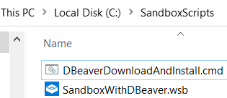
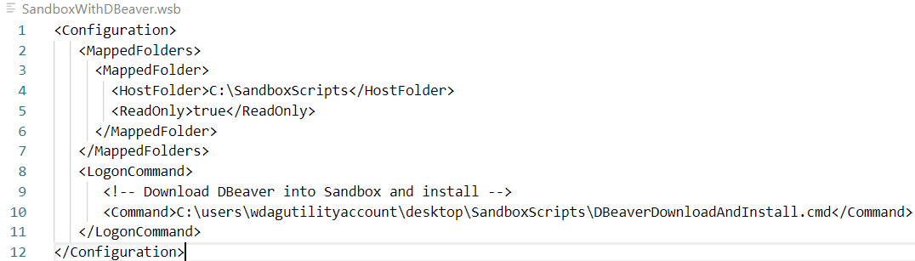
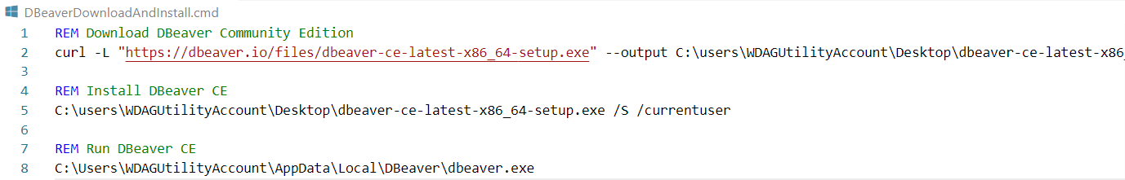
Run Windows Sandbox with DBeaver

Slide 23
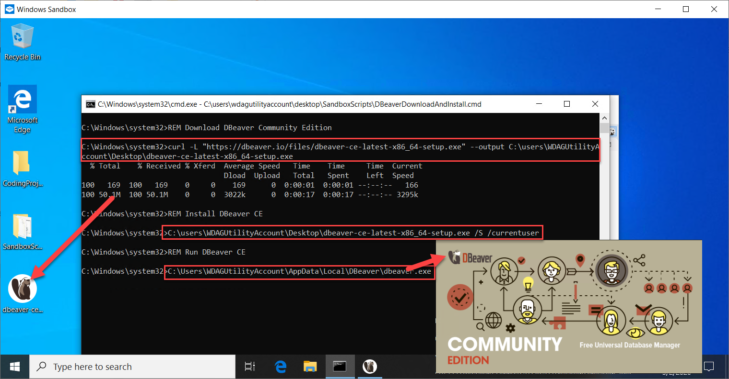
Run Windows Sandbox with DBeaver

Slide 24
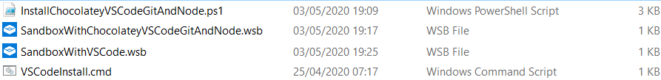
Other WSB configurations
Sandbox with VS Code
Sandbox with Scoop (a command line installer)
7Zip
Git Client
Sandbox with:
Chocolatey (like apt-get or yum or homebrew for Windows)
PowerShell V7
VS Code
Git Client
Node
LinqPad

Slide 25
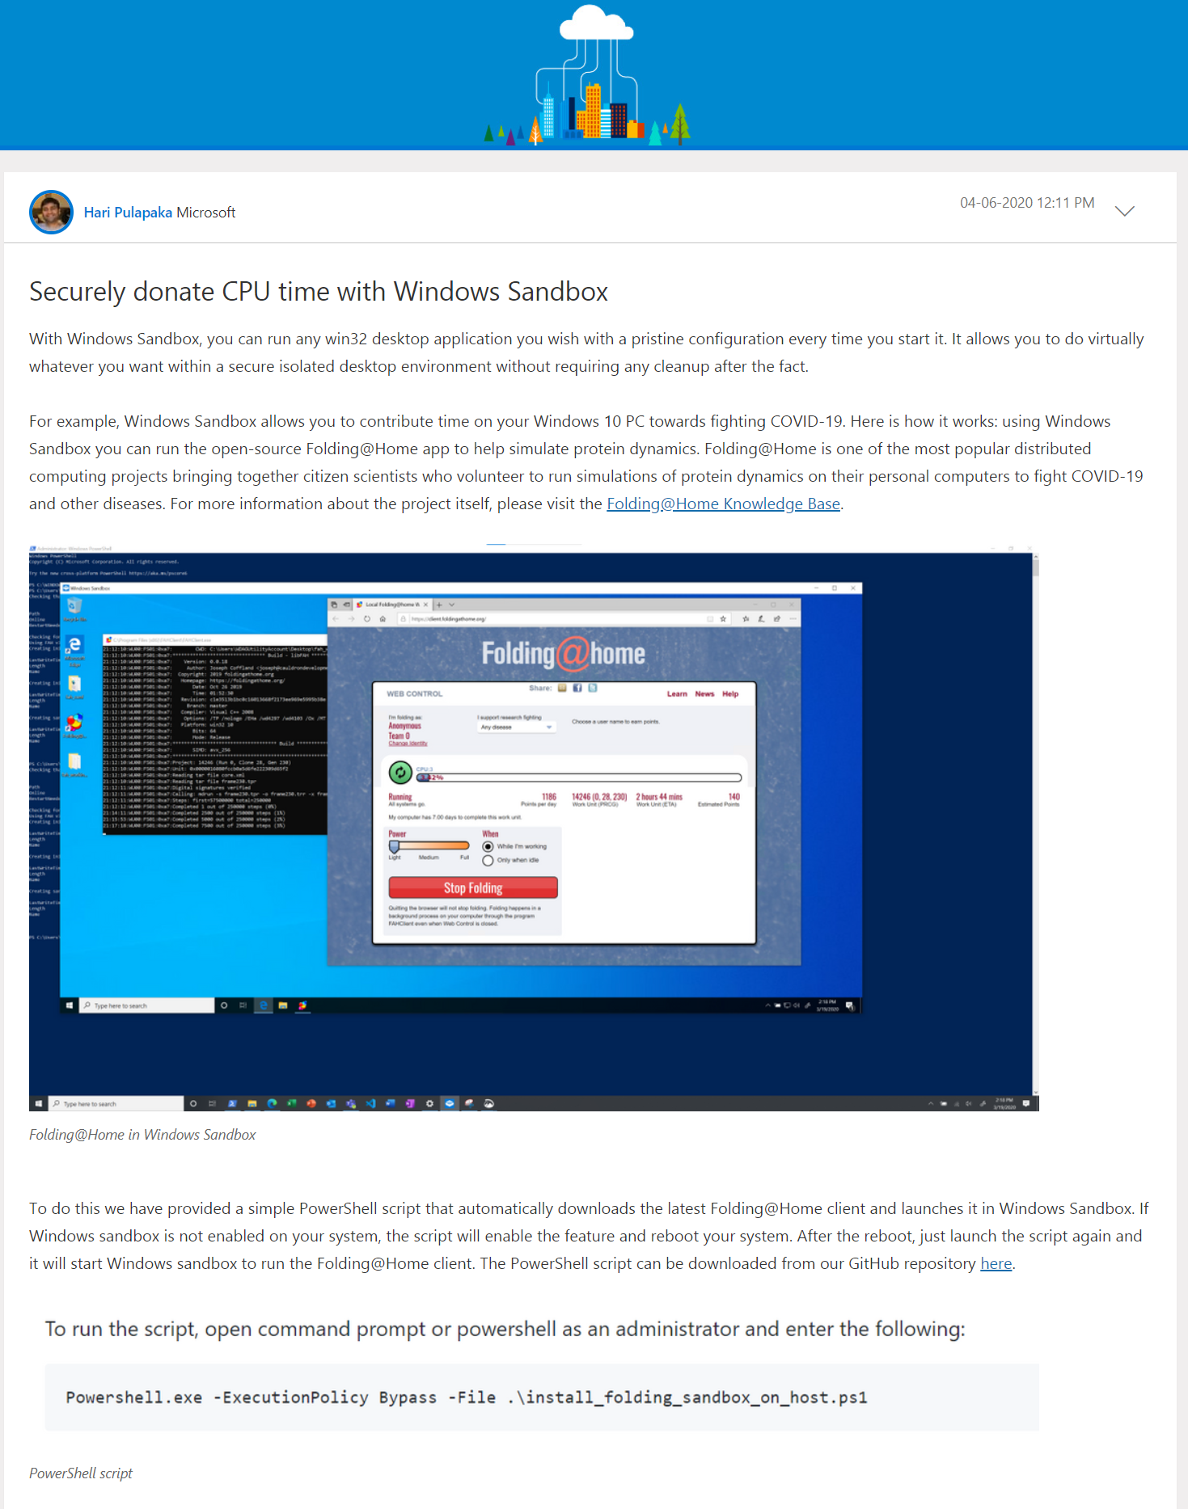
Folding@Home in Windows Sandbox

Slide 26
Thank you for your attention We hope this was useful
Code Café Online- 4 May 2020
Henk Jan van Wijk & Lucas Jellema
Resources: https://bit.ly/codecafe0405

Slide 27
Some candidate topics for Code Café
Chocolatey – Windows Package Manager
Scoop – a command line installer for Windows
VS Code & extensions
Ludwig – low code machine learning
Sheety - turns your Google Sheet into a fully RESTful JSON API.
Postwoman – browser based, free, fast and beautiful alternative to Postman
NodeGUI – native desktop UI with Node
Cloud Maker – visual Cloud solution designs (Azure, AWS, GCP)
n8n – workflow editing and execution with Node
Starship – Shell Prompt
GitDuck – Code, Video and Screen recording for developers
Cmder – console emulator for Windows
Sampler - tool for shell commands execution, visualization and alerting
Cartography - consolidates infrastructure assets and the relationships between them in an intuitive graph view
Feature Peek - Front-end review for the whole team
Notes:
https://stackshare.io/posts/top-developer-tools-2019

Slide 28

ISDb: International Session|Seminar Database
S
Find Video Recordings of Conference Sessions, Webinars, Online Meetups, Tutorials
Links to Download or Stream recording
Details about the speaker(s), session topics and content
Associated resources (demo scripts, articles, URLs, podcast, …)
Reviews
Suggestions for other session recordings
Favorites and Share

Slide 29







Title, Abstract, Tags & Topics
Language, Date,Thumbnail Duration,Level, Code?, Demo?
URL for Stream or Download
Name, Bio, Photograph, Publications, Social Media contact details
Speaker
Name, Location & Venue, Dates, Organization, Website, Social Media, calendar
Resource
Session
Event
Slides, Code, Article, Book, related sessions, Photographs
Review
Reviewer
Tags & Topics, Notes, Favorite?, AttendedLive?
Score: content, technical recording quality, speaking style
Name, Bio, Photograph, Publications, Social Media contact details

Slide 30
Title, Abstract, Tags & Topics
Language, Date, Thumbnail Duration, Level, Code?, Demo?
URL for Stream or Download
Conference, Course, Tutorial Series, Meetup Group, User Group, Blog, Magazine, Project, Site
Content Producer
Contributor
Name, Bio, Photograph, Publications, Social Media contact details
Context
Blog
Related Resource
Content Item
Context Link
Magazine
Slides, Code, Article, Book, Session, Tutorial, Tool, Product, App, Podcast
User Group
Seminar Series
Event
Review
Reviewer
Tags & Topics, Notes, Favorite?, AttendedLive?
Score: content, technical recording quality, speaking style
Name, Location & Venue, Dates, Organization, Website, Social Media, calendar
Name, Bio, Photograph, Publications, Social Media contact details

